Slide 1
Everything You Wanted to Know About RDMA But Were Too Proud to Ask
Live Webinar
March 26, 2025
10:00 am PT / 1:00 pm ET

Slide 2
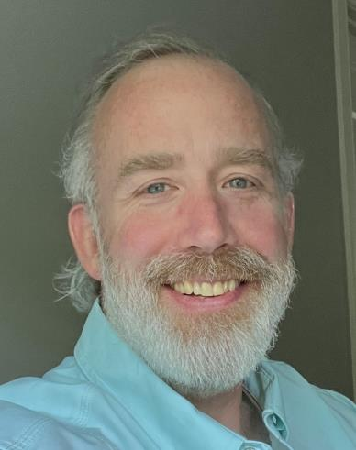


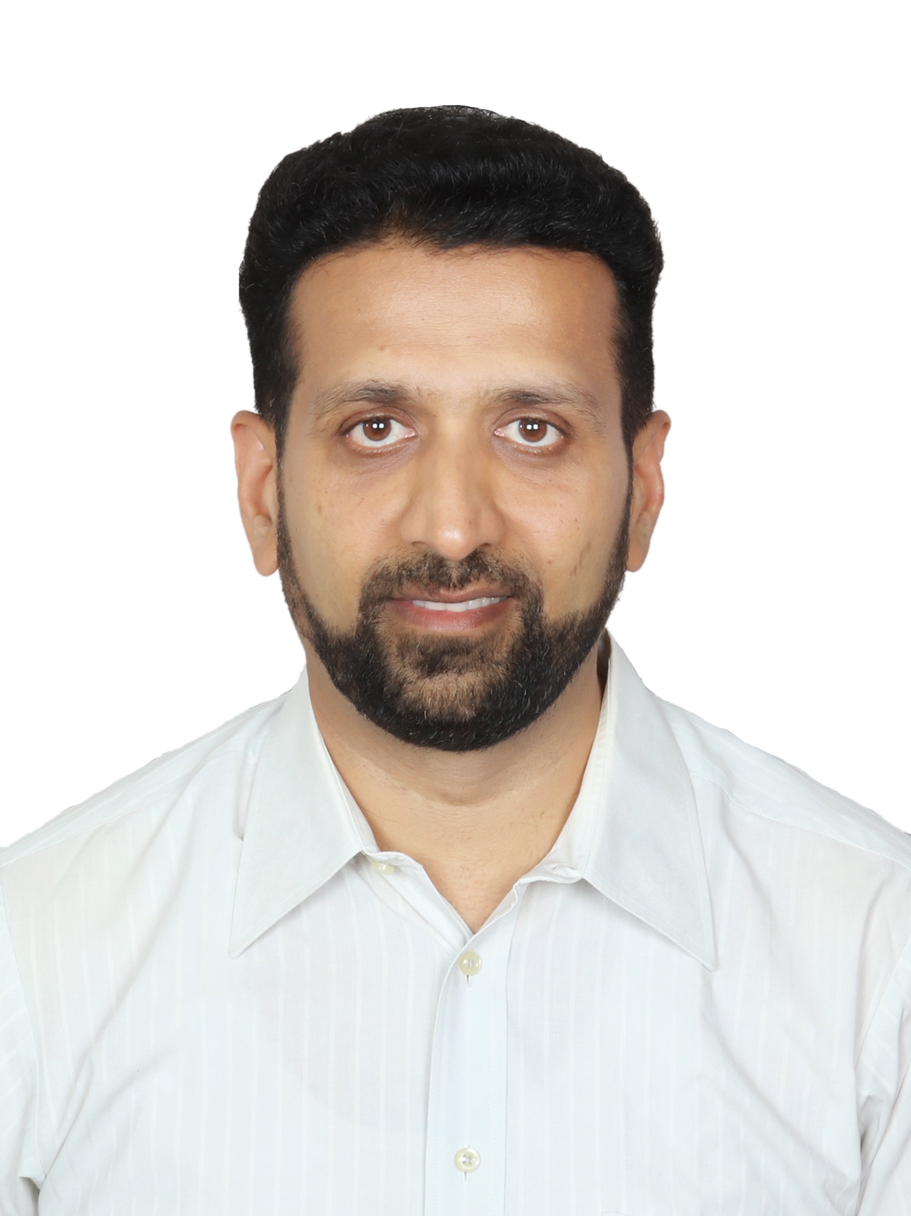
Today’s Presenters
Erik Smith
Distinguished Engineer
Dell Technologies
Moderator
Michal Kalderon
Distinguished Engineer, Software Architect
Marvell
Rohan Mehta
Senior Software Engineer
Microsoft
Notes:
2

Slide 3
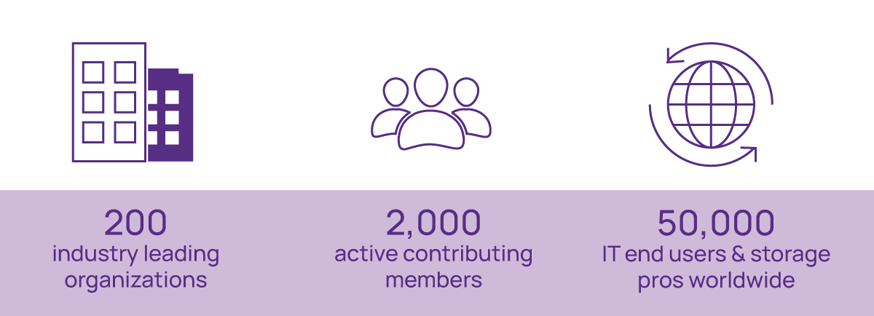
The SNIA Community

Slide 4

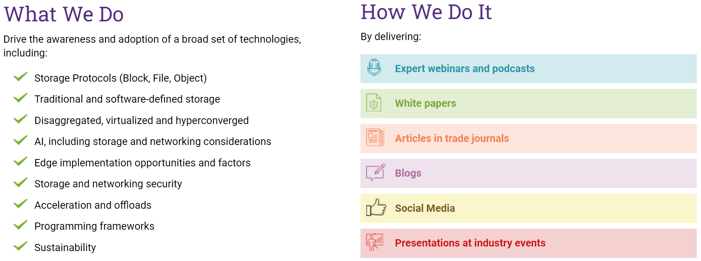

Slide 5
Logistics
The slides are available under the attachments tab at the bottom of your console.
Questions are welcome!
Please rate the session and provide feedback!
Want more sessions like this or other topics, let us know!
  JOIN US! We meet on Thursday mornings at 10 AM eastern.
  Email dsn-chair@snia.com if you have questions.

Slide 6
SNIA Legal Notice
The material contained in this presentation is copyrighted by SNIA unless otherwise noted.
Member companies and individual members may use this material in presentations and literature under the following conditions:
  Any slide or slides used must be reproduced in their entirety without modification
  SNIA must be acknowledged as the source of any material used in the body of any document containing material from these presentations.
This presentation is a project of SNIA.
Neither the author nor the presenter is an attorney and nothing in this presentation is intended to be, or should be construed as legal advice or an opinion of counsel. If you need legal advice or a legal opinion please contact your attorney.
The information presented herein represents the author's personal opinion and current understanding of the relevant issues involved. The author, the presenter, and the SNIA do not assume any responsibility or liability for damages arising out of any reliance on or use of this information.
NO WARRANTIES, EXPRESS OR IMPLIED. USE AT YOUR OWN RISK.

Slide 7
Agenda
What is RDMA ?
RDMA – Technical Details
Use Cases
Key Takeaways

Slide 8
What is (R)DMA?
DMA - Direct Memory Access: Allow hardware components to directly read from and write to the main memory without involving the CPU
RDMA - Remote Direct Memory Access: Extends DMA capabilities over a network, enabling one computer to directly access the memory of another computer without involving their CPUs, cache, or OS
Benefits of RDMA
Zero copy data
Bypasses the CPU
Bypasses the OS kernel
Message based transactions
Low Latency
High Bandwidth

Slide 9
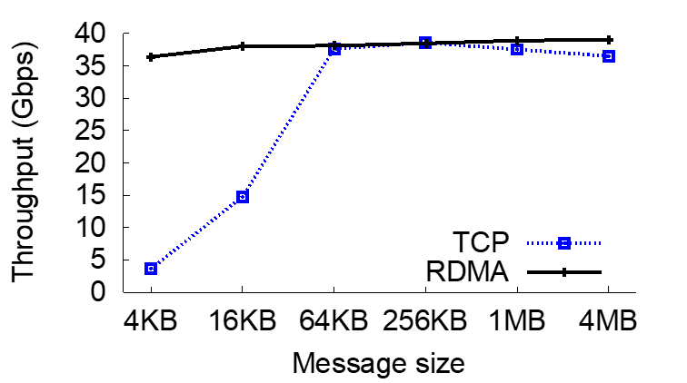
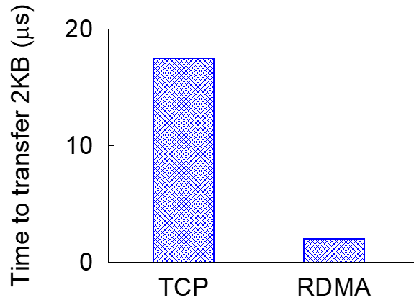
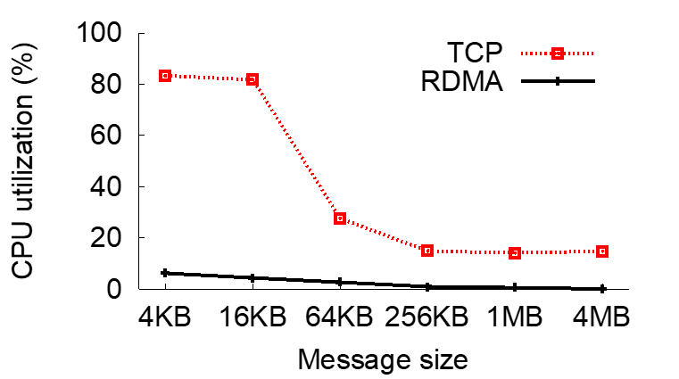
Performance Improvements
1
Increase throughput up to 86%
2
Reduced latency up to 88%
3
Reduced CPU usage up to 65%
https://conferences.sigcomm.org/sigcomm/2015/pdf/papers/p523.pdf
Notes:
TCP – 10-20% CPU usage for a 40Gbps link, 10-20 us rack latency
RDMA – less than 1% CPU usage, 2-5 us latency
- Low jitter and no throughput collapse (like in TCP)
- Low latency
- Low CPU utilization (while maintaining high throughput)

Slide 10
RDMA – A Historical Timeline
Early Days (1990s)
1993: RDMA concept outlined in HP patent
Mid-1990s: Early RDMA research and development for HPC
1995: Paper on parallel computing using standard servers laid the groundwork
InfiniBand Era (2000s)
1999: InfiniBand Trade Association (IBTA) formed
2000: InfiniBand Architecture Specification v1.0 released
Early 2000s: InfiniBand gains traction in HPC (Mellanox a key player)
Mid-2000s: Intel and Microsoft shift focus to PCIe
Ethernet Integration (2010s)
2010: RoCE (RDMA over Converged Ethernet) introduced
2014: RoCE v2 released with improved performance
Late 2010s: RoCE adoption grows in data centers
Commercial Deployments & Growth (2010s - Present)
Early 2010s: Early adopters in cloud and finance
Mid-2010s: NVMe over Fabrics (NVMe-oF) drives further adoption
Late 2010s: Essential for AI and machine learning
2019: NVIDIA acquires Mellanox
Present: Continued evolution and key role in high-performance computing, cloud, and AI

Slide 11
The Message Passing Programming Model
Application
Application
Application
Buffer
Buffer
Buffer
Application
Application
Application
Buffer
Buffer
Buffer

Slide 12
Message Passing over TCP
SERVER
SERVER
Application
Application
Buffer
Buffer
Sockets
Sockets
Transport
Transport
NIC Driver
NIC Driver
NIC
NIC
TCP/IP

Slide 13
Message Passing over RDMA
SERVER
SERVER
Application
Application
Buffer
Buffer
Sockets
Sockets
Transport
Transport
NIC Driver
NIC Driver
RNIC
RNIC
RDMA

Slide 14
TCP vs. RDMA
SERVER
SERVER
SERVER
SERVER
Application
Application
Application
Application
Buffer
Buffer
Buffer
Buffer
Sockets
Sockets
Sockets
Sockets
Transport
Transport
Transport
Transport
NIC Driver
NIC Driver
NIC Driver
NIC Driver
NIC
NIC
RNIC
RNIC
TCP/IP
RDMA

Slide 15
RDMA – Technical Details
Objects, Connection Management, Verbs, On the Wire

Slide 16
RDMA Operations
Channel Semantics: Send / Recv
Write: Writes data directly to a specified location in the remote memory.
Atomic Operations: Performs atomic read-modify-write operations on remote memory.
Memory Semantics: Read / Write / Atomic
Send Operation: Sender sends a message to the receiver.
Read: Reads data from the remote memory into the local memory.
Receive Operation: Receiver needs a corresponding operation to handle the incoming data.
Notes:
Send – similar to channel semantics
Initiator does not know where data is going on remote side
Remote side places data in next available receive buffer for the QP

Slide 17
RDMA Main Objects
Application
Application
Buffer
Buffer
QP
CQ
MR
QP
CQ
MR
WQE
WQE
CQE
VA
WQE
WQE
CQE
VA
Send Queue
Recv Queue
Send Queue
Recv Queue
WQE
WQE
CQE
RKEY
WQE
WQE
CQE
RKEY
WQE
WQE
CQE
LKEY
WQE
WQE
CQE
LKEY
RNIC
RNIC
RDMA

Slide 18
Queue-Pairs (QP)
Used by consumer (application) to submit operations to the RNIC
QP consists of
  Send-Queue (SQ)
  Receive-Queue (RQ)
Each consumer can have multiple QPs
WQEs – Work Queue Elements posted on the SQ / RQ
Application
QP
QP
WQE
WQE
QP
WQE
WQE
QP
Send Queue
Recv Queue
WQE
WQE
WQE
WQE
QP
Send Queue
Recv Queue
WQE
WQE
WQE
WQE
WQE
WQE
Send Queue
Recv Queue
WQE
WQE
WQE
WQE
WQE
WQE
Send Queue
Recv Queue
WQE
WQE
WQE
WQE
Recv Queue
Send Queue
WQE
WQE
WQE
WQE
WQE
WQE
Opcode
Address
length
WQE
Notes:
Some examples
AI Training: Multiple QPs for parallel data transfers between GPUs.
NVMe-oF: Multiple QPs for optimized I/O operations.
Full Cluster Connectivity: Multiple QPs ensure efficient communication across all nodes.

Slide 19
Completion Queues (CQs)
CQs indicate completions for WQEs placed on SQ and RQ
Consumer can have multiple CQ-s
SQs and RQs are mapped to a CQ
CQ can serve multiple SQs/RQs
NOT a 1:1 mapping
Two methods for processing CQs:
  Polling mode: Low latency, high throughput but CPU intensive
  Interrupt-based mode: Reduces CPU usage and power. Higher latency complexity
Application
CQ
CQ
CQE
CQ
CQE
CQE
CQ
CQE
CQE
CQE
CQE
CQE
CQE
CQE
CQE
CQE
WR_ID
Status
CQE

Slide 20
Memory Region (MR)
Application
Buffer1
Buffer2
Application register region of memory – MR
Allows RNIC to read/write from this memory
Registration pins the memory location
RNIC returns L-KEY and R-KEY
  L-KEY – used by local APP
  R-KEY – used by remote APP
L_Key / R_Key, with the offset in the MR and length, identify the location from which to read / write.
SGE
SGE
SGE
MR-1
MR-2
VA
VA
RKEY
RKEY
LKEY
LKEY
QP
WQE
WQE
Send Queue
Recv Queue
Opcode
SGE List
WQE
WQE
WQE
WQE
WQE
SGE
SGE
SGE
Notes:
Separate SGEs flexibility allows RDMA to handle complex data structures and optimize communication performance

Slide 21
Revisiting…
Application
Application
Buffer
Buffer
QP
CQ
MR
QP
CQ
MR
WQE
WQE
CQE
VA
WQE
WQE
CQE
VA
Send Queue
Recv Queue
Send Queue
Recv Queue
WQE
WQE
CQE
RKEY
WQE
WQE
CQE
RKEY
WQE
WQE
CQE
LKEY
WQE
WQE
CQE
LKEY
RNIC
RNIC
RDMA
Notes:
Send – similar to channel semantics
Initiator does not know where data is going on remote side
Remote side places data in next available receive buffer for the QP

Slide 22
Protection Domains (PD)
Group objects that can work together
Associated with QPs, MRs, SRQs MWs.
RNIC validates that the MR has the same PD domain as the QP on which it is posted / received.
  If not, there will be a completion with error

Slide 23

Shared Receive Queue (SRQ)
Shared Receive Queue between QPs
QP can be created with SRQ instead of RQ
More efficient in memory consumption
QP
QP
QP
WQE
WQE
WQE
Send Queue
Send Queue
Send Queue
WQE
WQE
WQE
WQE
WQE
WQE
SRQ
WQE
Shared Recv Queue
WQE
WQE

Slide 24
Connection Management
Four types of QP-s are supported:
  Reliable connection (RC) – mostly used (somewhat comparable to TCP)
  Unreliable connection (UC)
  Reliable datagram (RD)
  Unreliable datagram (UD) (somewhat comparable to UDP)
Connections are established out-of-band.
  Each wire protocol uses a different scheme.
    Infiniband defines protocol running over UD.
    iWARP defines a protocol running over TCP.
    Since it’s out-of-band can be emulated over sockets

Slide 25
XRC – Extended Reliable Connection
XRC allows significant savings in the number of QPs required to establish all to all process connectivity in large clusters.
Single XRC Initiator QP a process in one node can communicate with ALL processes on one remote node, thus reducing by a factor of p the number of overall QPs required for full connectivity (as compared RC QPs)
QPs = N_{nodes} x N_{processes}
Decrease from N_{nodes} x N_{processes}²

Slide 26
QP – RC Connection Example
Node 1
Node 2
Process-1
Process-1
QP-1
QP-10
QP-2
QP-11
QP-3
QP-12
Process-2
Process-2
QP-4
QP-13
QP-5
QP-14
QP-6
QP-15
Process-3
Process-3
QP-7
N*p*p
N=2, p=3, p=3
Num QPs=2*3*3=18
QP-16
QP-8
QP-17
QP-9
QP-18
Notes:
Nodes=2
Processes/cores=3 at each node

Slide 27
QP – XRC Connection Example
Node 1
Node 2
Process-1
Process-1
QP-1
Receive
QP-1
QP-1
SRQ
Process-2
Process-2
QP-2
QP-2
Receive
QP-2
SRQ
N*p
N=2, p=3
Num QPs=2*3=6
Process-3
Process-3
Receive
QP-3
QP-3
QP-3
SRQ
Shown in one direction for simplicity, but the QPs on each side are symmetrical
Notes:
Node 1 has same RQ to SRQs associations.

Slide 28
RDMA Verbs
Verbs provide an abstract definition of the functionality provided to a host by a RDMA NIC.
An operating system may expose some or all of the verb functionality through its programming interface.
Same Verbs for all wire-protocols.

Slide 29
Slow-Path Verbs Operations
Slow-path operations involve privileged driver, Main verbs:
Device related
Open / close device
PD (Protection Domain)
Allocate / De-allocate
MR (Memory Region)
Register / de-register
QP (Queue Pair)
Create / destroy / modify
CQ (Completion Queue)
Create / resize / destroy
SRQ (Shared Queue Pair)
Create / resize / destroy

Slide 30
Fast-Path / Data-Path Verbs
Fast-path operations can be done from either user-space or a privileged driver.
Send operations
Send operation consumes a RQ entry in the peer
All memory used in transfers must be registered
Receive operations
Post RQ receive
user application must ensure a send is not posted on one side before a corresponding recv has been posted on the other side
RDMA operations
RDMA write, RDMA read
Atomic operations (fetch and add, compare and swap)
Memory operations
Bind MW, Fast register MR
Local invalidate

Slide 31

Putting it all together:
How does an app look?
What goes on the wire?

Slide 32
Typical App Stages Overview
Hosts initialize context and register memory regions
Establish connection
Use Send/Receive model to exchange memory region keys between peers
Post read/write operations
Disconnect

Slide 33


Initialization
Hosts initialize context and register memory regions
Server
Application
Client
Application
RNIC
RNIC
RDMA
Notes:
Send – similar to channel semantics
Initiator does not know where data is going on remote side
Remote side places data in next available receive buffer for the QP

Slide 34

Initialization
Hosts initialize context and register memory regions
Target (Server) | Initiator (Client)
Create an event channel to receive rdmacm events connection-request connection-established notifications | Create an event channel to receive rdmacm events address-resolved route-resolved connection-established notifications
Bind to an address | Create a connection identifier
Create a listener and return the port/address | Resolve the peer’s address, which binds the connection identifier to a local RDMA device
Wait for a connection request | Resolve the route to the peer
 | Create a PD, CQ, QP

Slide 35
Initialization
Hosts initialize context and register memory regions
Server
Application
Client
Application
RQ buffers
SQ buffers
RQ buffers
RQ buffers
QP
CQ
WQE
CQE
Send Queue
Recv Queue
WQE
CQE
WQE
WQE
CQE
RNIC
RNIC
RDMA
Notes:
Send – similar to channel semantics
Initiator does not know where data is going on remote side
Remote side places data in next available receive buffer for the QP

Slide 36
Initialization
Establish connection
SERVER (Passive) | Client (Active)
Create an event channel to receive rdmacm events connection-request connection-established notifications | Create an event channel to receive rdmacm events address-resolved route-resolved connection-established notifications
Bind to an address | Create a connection identifier
Create a listener and return the port/address | Resolve the peer’s address, which binds the connection identifier to a local RDMA device
Wait for a connection request | Create a PD, CQ, QP
Create a PD, CQ, QP | Resolve the route to the peer
Accept the connection request | Connect
Wait for connection to be established | Wait for connection to be established
Post operations as appropriate | Post operations as appropriate

Slide 37
Initialization
Establish connection
Server
Application
Client
Application
RQ buffers
SQ buffers
S-Buffer
RQ buffers
SQ buffers
C-Buffer
RQ buffers
RQ buffers
RQ buffers
RQ buffers
QP
CQ
MR
QP
CQ
MR
WQE
CQE
VA
WQE
CQE
VA
Send Queue
Recv Queue
Send Queue
Recv Queue
WQE
CQE
RKEY
WQE
CQE
RKEY
WQE
WQE
CQE
LKEY
WQE
WQE
CQE
LKEY
RNIC
RNIC
RDMA
Notes:
Send – similar to channel semantics
Initiator does not know where data is going on remote side
Remote side places data in next available receive buffer for the QP

Slide 38
Connection Setup
Initiator
Target
GSI
QP1
ConnectRequest-1(BTH:dQP=1, DETH:sQP1, MAD:REQ:lQPN=100, l-CommID=A)
GSI
QP1
ConnectReply-1(BTH:dQP=1, DETH:sQP1,MAD:REP:lQPN=200,lCommID=B, rCommid=A)
Local QPN
100
Local QPN
200
Example IB Initialization & Connection Setup-1-Create “Admin” Connection & QP
Notes:
GSI (Global Service Interface) is a special Queue Pair (QP) used for communication management in RDMA. It handles administrative tasks like connection establishment and teardown. Used for out of band connection life cycle handling
MAD (Management Datagram) is a type of message used for managing and configuring RDMA devices. It includes information necessary for device management.
BTH Header (Base Transport Header) is part of the RDMA packet that contains essential information for routing and managing the packet, such as the packet type and destination.
DETH Header (Data Extended Transport Header) is used in RDMA packets to provide additional information for data transfer, including the destination and source addresses.
Comm-ID (Communication Identifier) is a unique identifier used to manage and track RDMA connections. It helps in distinguishing between different communication sessions.
Send Connect Request from General Service Interface (GSI) QP1 to remote GSI QP1

Slide 39
Connection Setup - Ready-to-Use
Initiator
Target
GSI
QP1
ReadyToUse-1(BTH:dQP=1,DETH:sQP1,MAD:RTU:local CommID=A,remote CommID=B
GSI
QP1
Exchange memory region information
Local QPN
100
Local QPN
200
Example IB Initialization & Connection Setup-2-Send Ready To Use & Exchange Info
Notes:
Send Connect Request from General Service Interface (GSI) QP1 to remote GSI QP1
From RDMA Write trace
1st Connect Request
Local QPN = 266
Local CommID = B7 D4 DD 8A
!st Connect Reply
Local QPN = 26C
Remote QPN = 266
Remote Comm ID = E8 58 D6 CC
RTU = B7 D4 DD 8A / E8 58 D6 CC
2nd Connect
Local Comm ID = B0 D4 DD 8A
Remote Comm ID = E8 58 D6 CC
RTU = B0 D4 DD 8A / EB 58 D6 CC

Slide 40
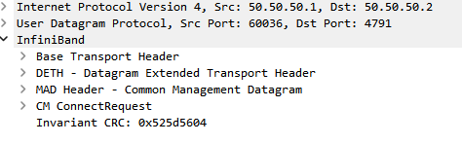
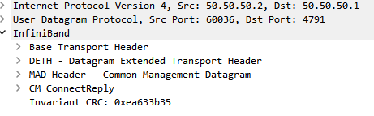
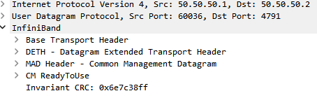
On the Wire…
ConnectRequest
ConnectReply
ReadyToUse

Slide 41
Send / Recv Model
Use Send/Receive model to exchange memory region keys between peers
Server
Application
Client
Application
RQ buffers
SQ buffers
S-Buffer
RQ buffers
SQ buffers
C-Buffer
RQ buffers
RQ buffers
RQ buffers
RQ buffers
QP
CQ
MR
QP
CQ
MR
WQE
CQE
VA
WQE
CQE
VA
Send Queue
Recv Queue
Send Queue
Recv Queue
WQE
CQE
RKEY
WQE
CQE
RKEY
WQE
WQE
CQE
LKEY
WQE
WQE
CQE
LKEY
OP: SEND
SGE: SQ buffer
OP: SEND
SGE: SQ buffer
RNIC
RNIC
RDMA
Notes:
Send – similar to channel semantics
Initiator does not know where data is going on remote side
Remote side places data in next available receive buffer for the QP

Slide 42
Example Send – 8k (MTU=2K)
Initiator
Target
Local QPN
100
Send First(PSN=1,Ack=0/Pld=2048)
Local QPN
200
Send Middle(PSN=2,Ack=0/Pld=2048)
Send Middle(PSN=3,Ack=0/Pld=2048)
Send Last(PSN=4,Ack=1/Pld=2048)
Ack(PSN=4)

Slide 43
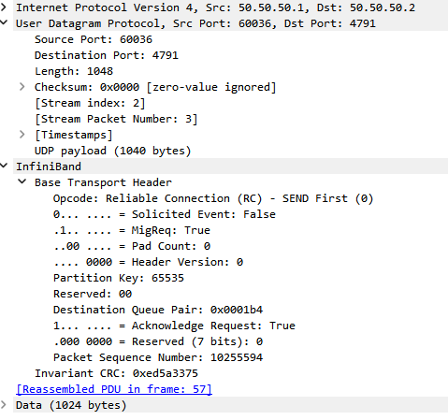
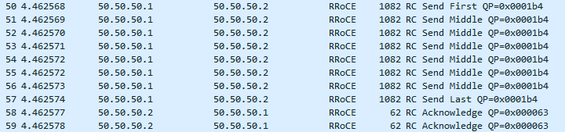
On the Wire Send – 8K (MTU=1K)

Slide 44

READ/WRITE Operations
Post read/write operations
Server
Application
Client
Application
RQ buffers
SQ buffers
S-Buffer
RQ buffers
SQ buffers
C-Buffer
RQ buffers
RQ buffers
RQ buffers
RKEY
RQ buffers
RKEY
QP
CQ
MR
QP
CQ
MR
WQE
CQE
VA
WQE
CQE
VA
Send Queue
Recv Queue
Send Queue
Recv Queue
WQE
WQE
CQE
RKEY
WQE
CQE
RKEY
WQE
WQE
CQE
LKEY
WQE
WQE
CQE
LKEY
OP: Write, length
Remote: rkey, addr
Local: lkey,addr
OP: Read, length
Remote: rkey, addr
Local: lkey,addr
RNIC
RNIC
RDMA

Slide 45
Example RDMA Write – 8k (MTU=2K)
Initiator
Target
Local QPN
101
RDMA Write First(PSN=1,Ack=0/VA=100,Rkey=Ah,DMAlen=8192/Pld=2048)
Local QPN
201
RDMA Write Middle(PSN=2,Ack=0/Pld=2048)
RDMA Write Middle(PSN=3,Ack=0/Pld=2048)
RDMA Write Last(PSN=4,Ack=1/Pld=2048)
Ack(PSN=4)

Slide 46
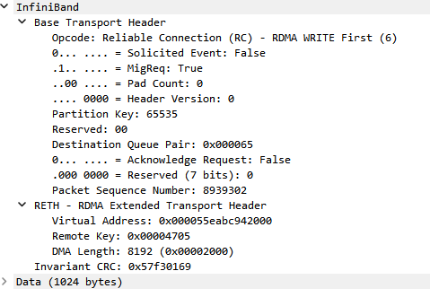
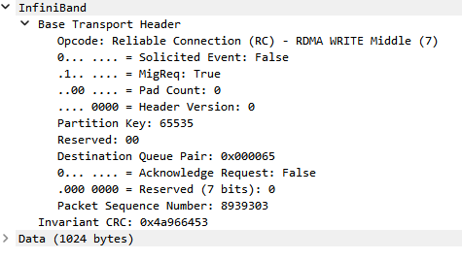
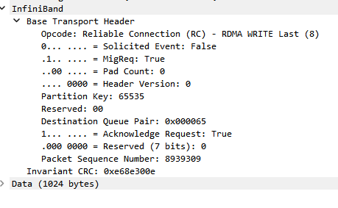
On the Wire RDMA Write (MTU=1K)
x6

Slide 47
Example RDMA Read – 8k (MTU=2K)
Initiator
Target
Local QPN
101
RDMA Read request(PSN=1,Ack=1/VA=100,Rkey=Ah,DMAlen=8192)
Local QPN
201
RDMA Read response First(PSN=1,Ack=0/ACK/Pld=2048)
RDMA Read response Middle(PSN=2,Ack=0/Pld=2048)
RDMA Read response Middle(PSN=3,Ack=0/Pld=2048)
RDMA Read response Last(PSN=4,Ack=0/ACK/Pld=2048)
Notes:
Note ACK in first and last response.

Slide 48
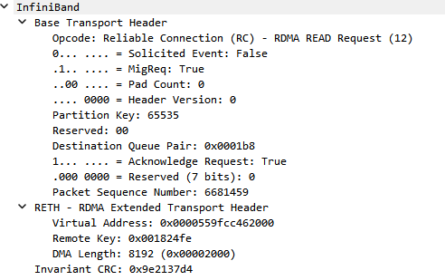
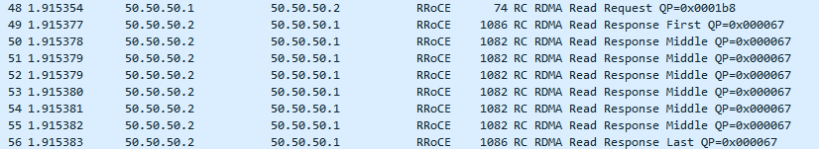
On the Wire Read (MTU=1K)

Slide 49
Transports and Congestion Control

Slide 50
RDMA Transports
Application
Verbs
IB Transport
IB Network
IB Link
IB Transport
IB Network
Eth Link
IB Transport
UDP/IP
Eth Link
iWARP
TCP/IP
Eth Link
InfiniBand
RoCEv1
RoCEv2
iWARP
InfiniBand
LRH
GRH
BTH+
RDMA Data
iCRC
vCRC
RoCEv2
Eth
IP
UDP
BTH+
RDMA Data
iCRC
FCS
iWARP
Eth
IP
TCP
iWARP*
(MPA,DDP)
RDMA Data
FCS
Notes:
Udp port number indicates next header is IB. BTH (Basic Transport Header).

Slide 51
RoCE – RDMA over Converged Ethernet
Upper layers are the same as in Infiniband
link and physical layers are replaced with Ethernet.
EtherType indicates RoCE (0x8915).
RoCE versions
RoCEv1 doesn’t contain an IP header, therefore it is not routable.
RoCEv2 over UDP (a.k.a “routable RoCE” )
Ethernet subnet management means are used.
Uses the ARP (Address Resolution Protocol) to get remote MAC address.
Requires a network interface on the same port.
Requires lossless operation – i.e. PAUSE / PFC.
Same as InfiniBand, but disadvantage comparing to iWARP.

Slide 52
Congestion Control
PFC (Priority Flow Control) pause frames are used to signal congestion to the source and throttle.
DCQCN (Data Center Quantized Congestion Notification) employs ECN (Explicit Congestion Notification) for signaling congestion feedback. Preferred for Storage workloads.
RoCC (Robust Congestion Control) utilizes switch queue size for fair data rate signaling.
Shaped-Quota is receiver-driven, optimizing bandwidth allocation. It abandons use of PFC.
RTTCC (Round Trip Time Congestion Control) uses RTT as a feedback signal in hardware for congestion control. Preferred for HPC and AI workloads.
Notes:
This slide covers the key methods of congestion control for RDMA. DCQCN employs ECN to manage congestion at the source, while RoCC focuses on the switch queue sizes to determine optimal data rates. Shaped-Quota takes a unique receiver-driven approach, eliminating the need for PFC and instead utilizing selective retransmission for improving reliability and performance.
1. DCQCN (Data Center Quantized Congestion Notification)
This is a widely used algorithm for RoCEv2.
It's a source-driven approach that uses Explicit Congestion Notification (ECN) in IP headers to signal congestion.
The destination sends feedback to the source, which adjusts its transmission rate.
While effective, it can have slow convergence and potential instability.
2. RoCC (Robust Congestion Control)
This approach uses switch queue size as input to a PI (Proportional-Integral) controller.
The controller calculates a fair data rate and signals it to the sources.
RoCC aims for stability, rapid convergence, and fair throughput.
It can significantly reduce the generation of PFC (Priority Flow Control) frames compared to DCQCN.
3. Shaped-Quota
This is a receiver-driven algorithm that uses traffic shaping and bandwidth reservation.
The receiver's NIC allocates bandwidth quotas based on active connections and sends them to the sender.
It abandons PFC and uses selective retransmission for reliability.
Key parameters like short message limit and bandwidth reservation ratio influence its performance.
5. Round Trip Time Congestion Control
Main ZTR-RTT CC algorithm's characters are : ​
Implemented on top of DPA (Data Path Accelerator) ​
RTT-based congestion control ​
Current default CC algorithm for RoCE ​
Demonstrates better performance than DCQCN on HPC and AI workloads​
Maintain DCQCN good performance on storage workload

Slide 53
Use Cases

Slide 54
Use Cases
High-Performance Computing (HPC)
Data Centers
Cloud Computing
Storage Solutions
Financial Services
AI/ML Training / Inference

Slide 55



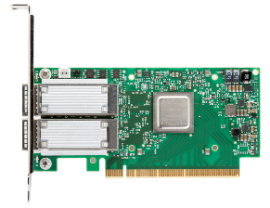
Guests
Cloud Computing
Hypervisor
SR-IOV
Hosts
Custom?
SMB
NFS
Switch
Physical Network

Slide 56
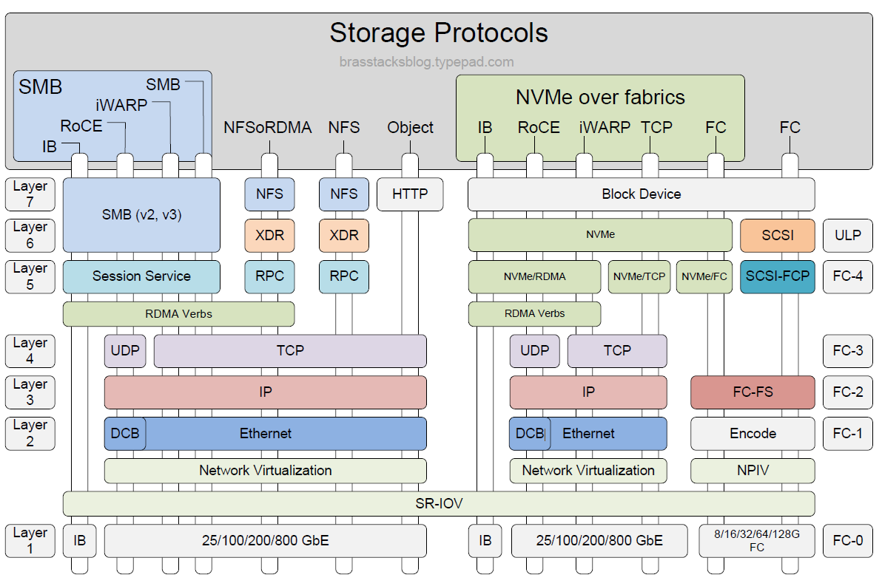

Storage Solutions

Slide 57
Key Takeaways
RDMA Benefits: Low latency, high throughput, Kernel bypass, Zero Copy
RDMA Objects
RDMA Use Cases
Typical Application
RDMA on the wire

Slide 58
Q&A

Slide 59
After this Webinar
Please rate this webinar and provide us with your feedback
This webinar and a copy of the slides are available at the SNIA Educational Library snia.org/educational-library
A Q&A from this webinar, including answers to questions we couldn’t get to today, will be posted on our blog at sniablog.org
Follow us on X/Twitter @SNIA

Slide 60
Thank you!

