Slide 1

Cooling Trends
Data Center Storage

Slide 2
High Temperature Ambient (HTA) Data Centers
EU Lot9 Task 7 Recommendations: Consider a higher inlet temperature such as ASHRAE Class A1 allowable temperature & humidity range. Implement A1 by 2018 and target A2 for 2022
Acknowledge potential issues with electronics reliability, higher acoustical noise from higher fan speeds, corrosion from higher temperature and humidity changes, and possible performance loss due to inappropriate thermal management
Sources: 2011 ASHRAE data center guidelines, and http://www.intel.com/content/dam/doc/technology-brief/efficient-datacenter-high-ambient-temperature-operation-brief.pdf

Slide 3
Storage OEM Benchmarking Survey
Maximum operational rated air inlet temperatures; 8 of the major storage array suppliers and more than 200 model offerings
Source: ASHRAE TC9.9 Storage White Paper 2015

Slide 4
Heat Load Footprints
C-Class Server rack up to 36 KW in some cases
Rack footprints are commonly 6-8 sq.ft.
Sources:
Datacom Equipment Power Trends and Cooling Applications, ASHRAE 2012
Updated Storage and Networking Trends,
ASHRAE TC9.9 Storage White Paper 2015

Slide 5
Source: T. Cader, “The Evolving Data Center; How Power, Cooling, and Standards are Driving Change” IMAP Sept 2015

Slide 8
Source: T. Cader, “The Evolving Data Center; How Power, Cooling, and Standards are Driving Change” IMAP Sept 2015

Slide 9
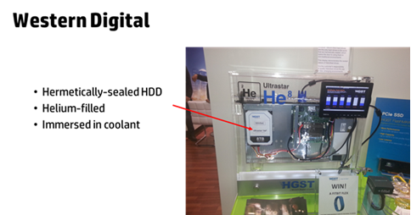

Slide 10
Alternative Energy at Production Data Centers
All images from Google.com

